Slide 1


MS Teams Online Teaching
Notes:
Welcome to our quick workshop
Mute all - let students know they are going to be muted
Screens off – if you have a question, turn your screen on. (you can do this with larger classes or have everyone’s video on and just have them raise their hand or use the hand raise tool)
Check in – give me a thumbs up if you can see me
Thumbs up if you can hear me
Thumbs up if you can see my screen

Slide 2
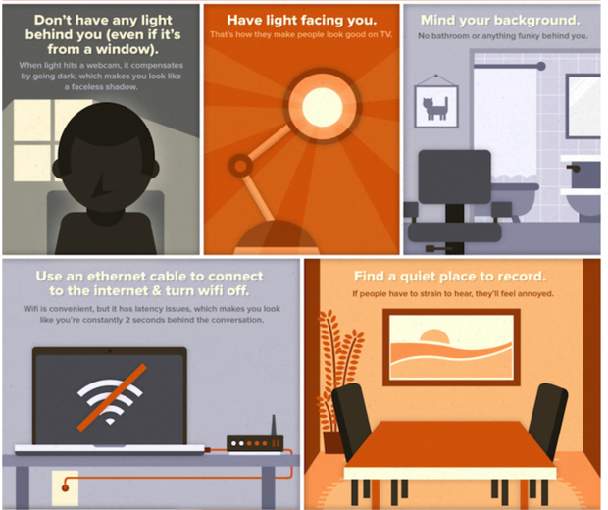
Setting up your space
Notes:
Having a good space is important for visually seeing each other
Lighting
Ethernet cable – turn wifi off if possible
Quiet space – if there are two people in the room it is important that you have voices off.
Why do you think it is important to not talk to the person beside you while learning ASL ?
Raise your hand and I’ll call on you to answer – unmute

Slide 3

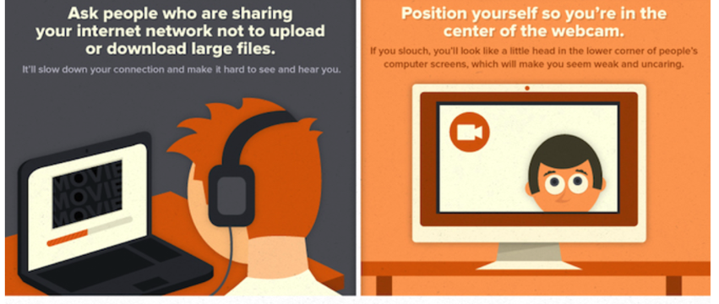
Setting up your space
Notes:
Make sure other programs are shut down
Try to ask others in your house to turn off their screens and not be online
Position yourself in the centre of your webcam

Slide 4
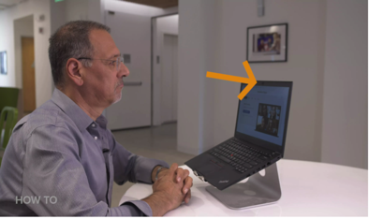
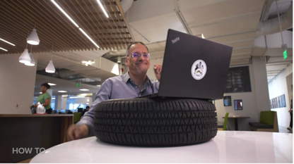
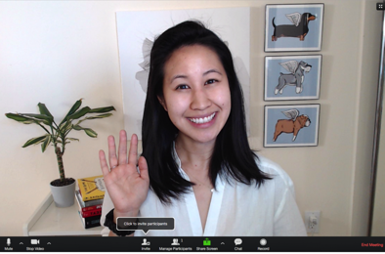
Setting up your space
Notes:
Tips for positioning yourself
Make the web camera at eye level. Some ways to do this is to put your computer on something to lift it up
Check that your face and hands are visible while signing see example
Questions about setting up your space?

Slide 5
MS Teams Features
Video meetings with close captions
Adjust your audio output
Have class discussions and share files
Hand in assignments
Can set up teams or channels for:
  larger groups of students (all your DHH students)
  Smaller groups of students (all high school students
  Individual student teams

Slide 6
MS Team: Video Meetings
Phone call feature in MS Teams does not allow for Closed Captions – you must set up a meeting
You must use the downloaded desktop version to access to closed captions feature
You can only view 4 screens at once but you can toggle between other screens as needed
You can share a Powerpoint or whiteboard

Slide 7
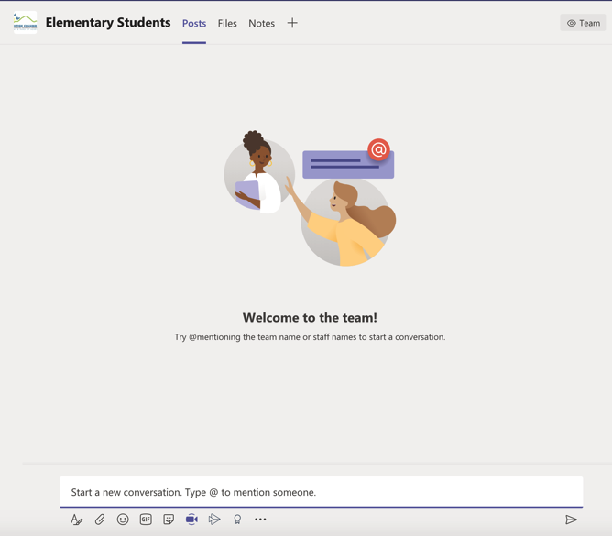
Setting up a video meeting #1
In a channel you can open the meeting to all members of the channel
Click “Meet Now” and it will send an invite to all members to join

Slide 8
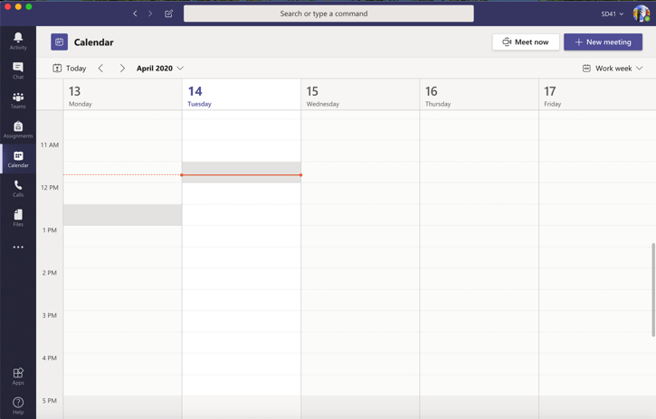
Setting up a video meeting #2
Go to Calendar
Either: Meet now – invite select participants OR Schedule a new meeting for a later date

Slide 9
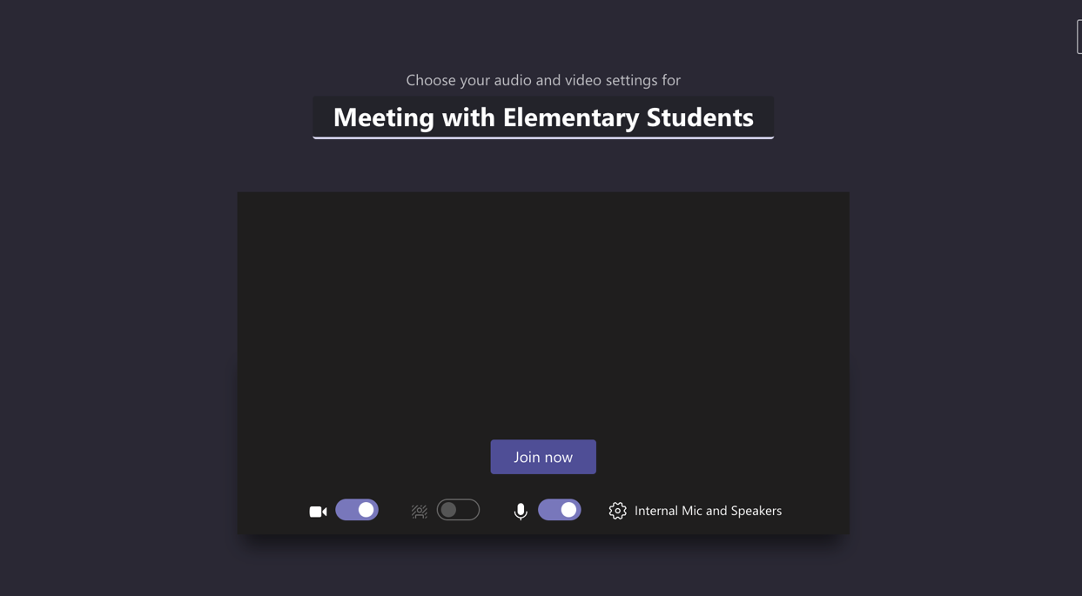
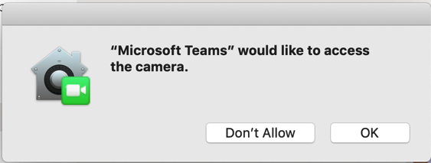
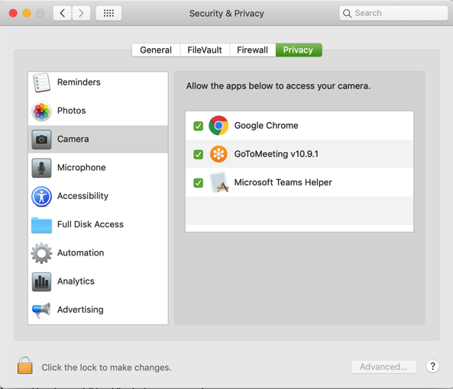
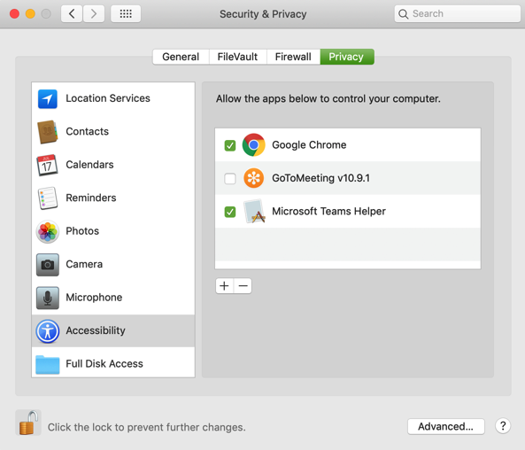
Notes:
When you start a meeting you will get this screen
This is where you allow access to your microphone and video
You also have the option to adjust your mic and speaker settings (you can use this to adjust a different audio output if you need a different listening device or to connect to a Bluetooth device)
Note if your video is not working, you may need to allow permissions within your computer. The permissions will be for video, audio and screen sharing. On a mac they look like this.

Slide 10
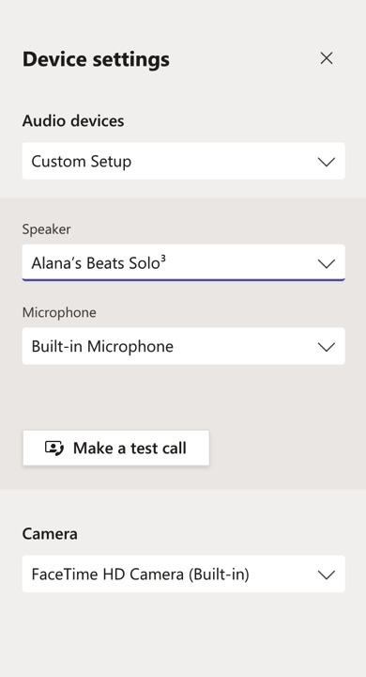
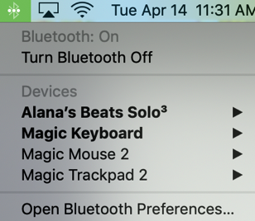
Audio Settings
When you enter audio settings you can adjust where the mic input comes from and speaker output goes.
If a student has a Bluetooth or USB device connected to the computer, you can select that device here.

Slide 11
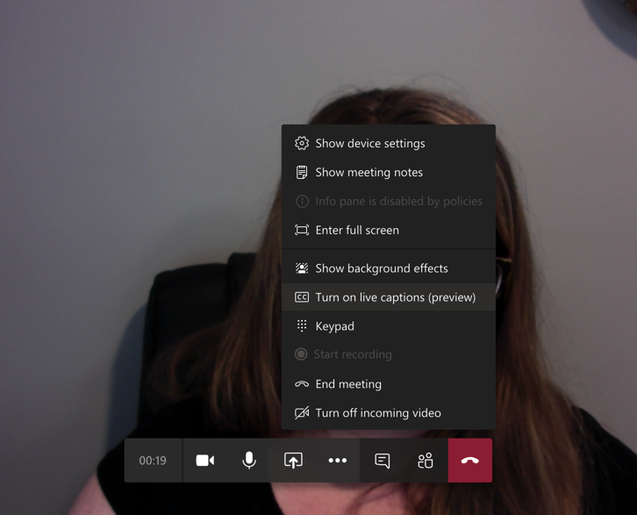
Turning on automated closed captioning
When in meeting, click on the 3 dots
Choose turn on CC
Uses the same software as Microsoft Translator and Skype (for accuracy information)
Accuracy depends on Wifi and mic location – always CART is best (see Zoom workshop for more info on CART)

Slide 12
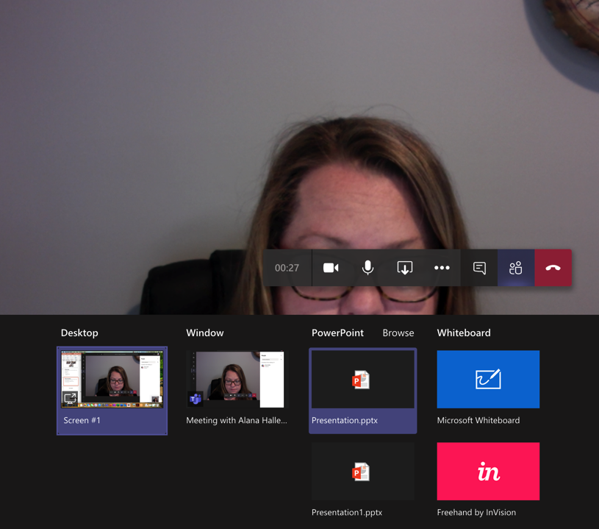
Screen Sharing
Share a powerpoint, video, document or your whole desktop with students (they do not have control just viewing rights)
Students can interact using the Whiteboard

Slide 13
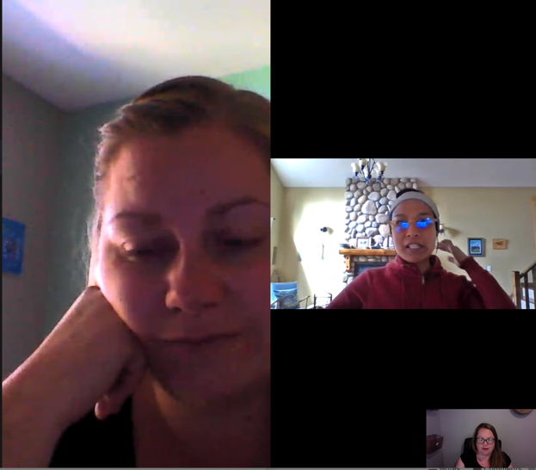
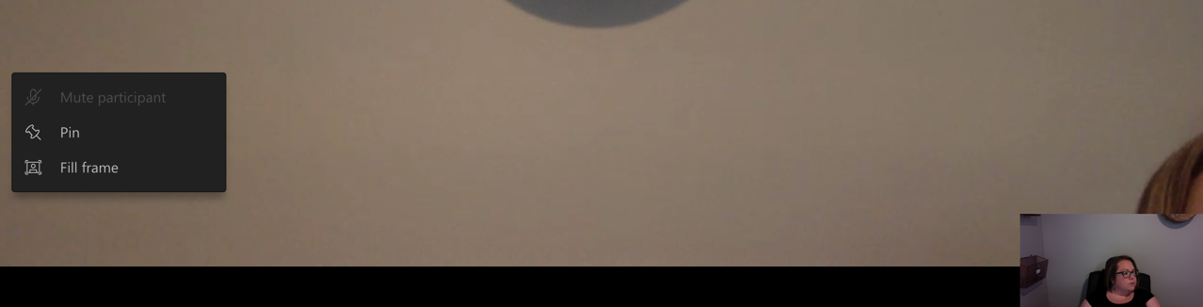
View Adjustment
Click on a participants screen to adjust view settings
Notes:
Helpful for students to pin the teacher’s screen to stay on.
Teachers can also use this to mute a participant if their mic is left on
Share screen how to start a meeting and turn on captions and share screen

Slide 14
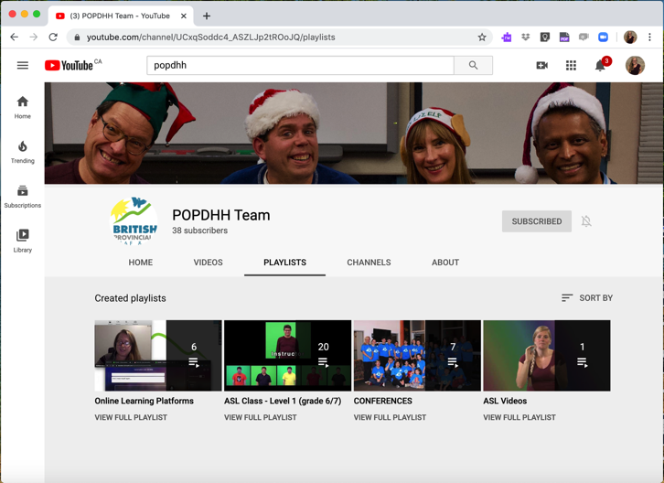
You Tube Review Videos
Find videos of how to log in and turn on CC in various formats on our POPDHH playlist
Online Learning Platforms

Slide 15
Thank you!
Alana Haller
Email me: alana@popdhh.ca
Notes:
Thank you, for your time
Are there any questions before we go?
If you would like further support please feel free to email me

